Slide 1
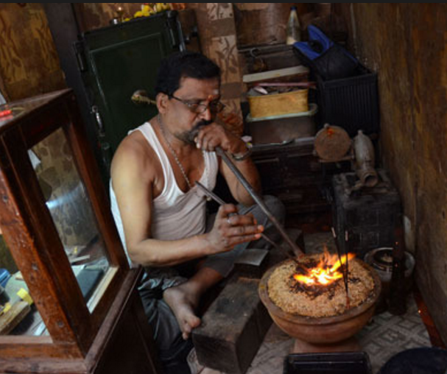
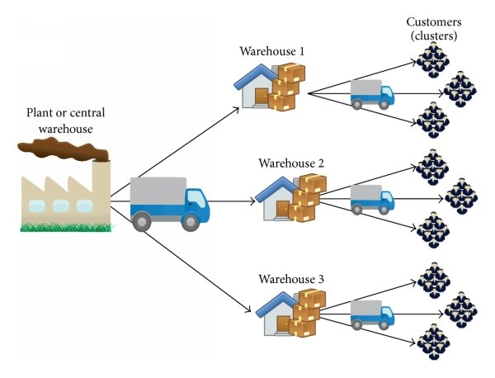
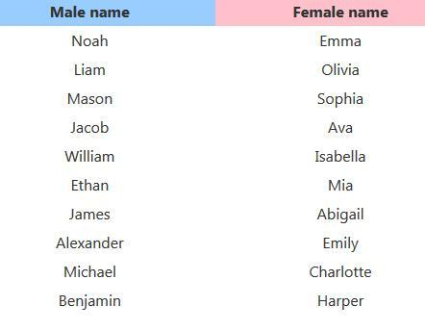
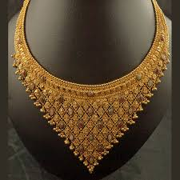
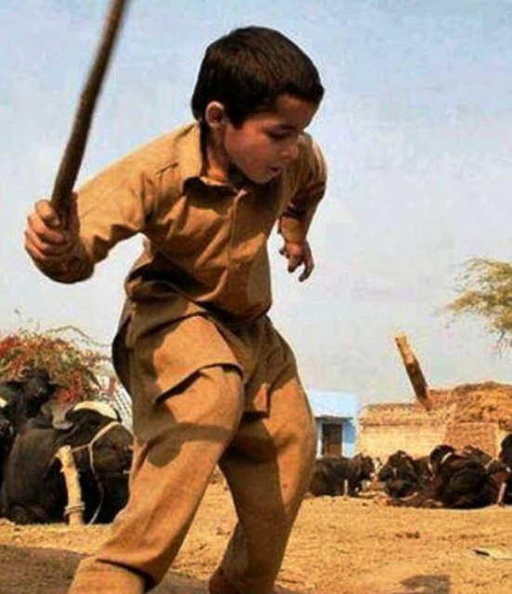
Puzzle #1
10/10 gold smith
18/19 distribution system
1/13 list_of_names
5/8 necklace
8/10 billangodu

Slide 2
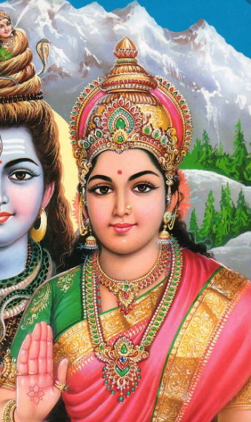

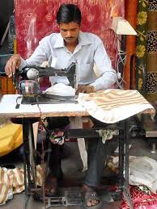
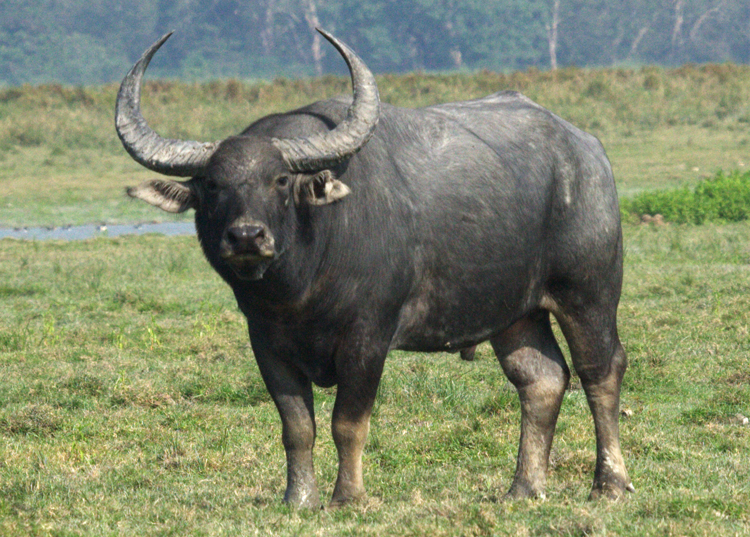

Puzzle #2
7/8 parvathi
5/10 to_be_done
4/6 tailor
6/7 buffalo
2/6 doctor

Slide 3
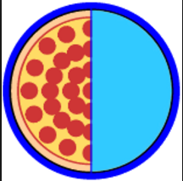
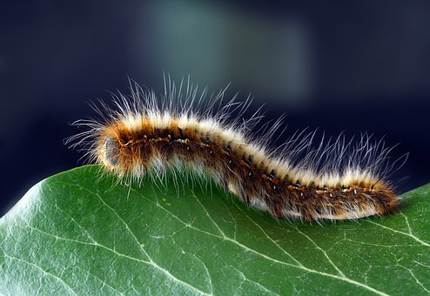
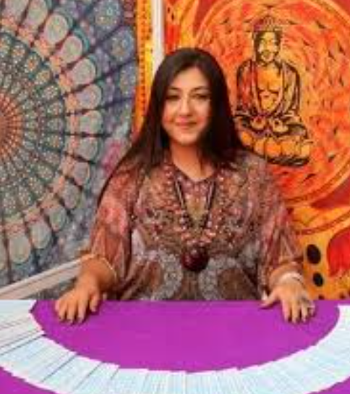
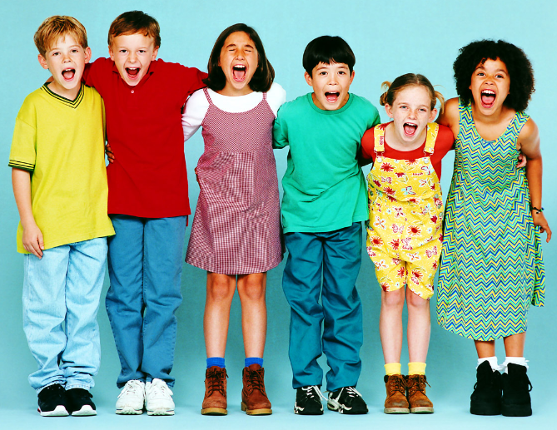

Puzzle #3
1/9 halfofthe
4/11 caterpillar
7/10 tarot lady
14/15 forboysandgirls
2/4 work

Slide 4
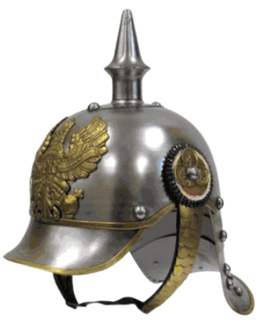
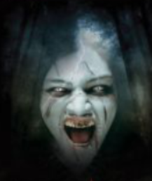
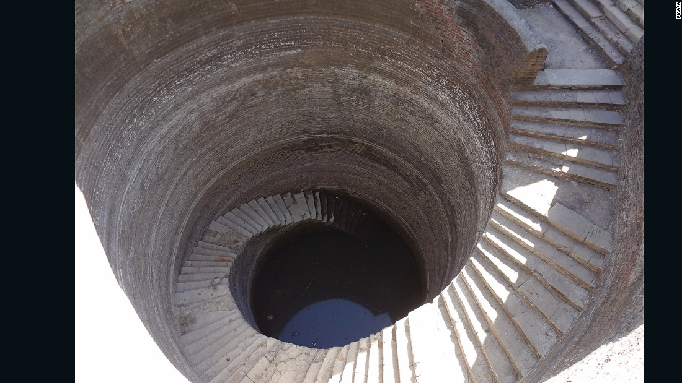
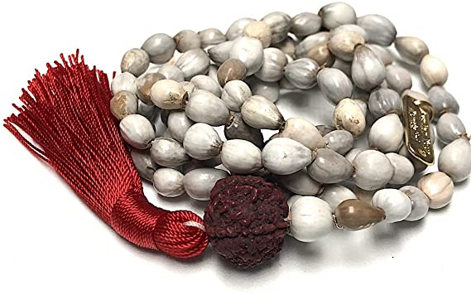
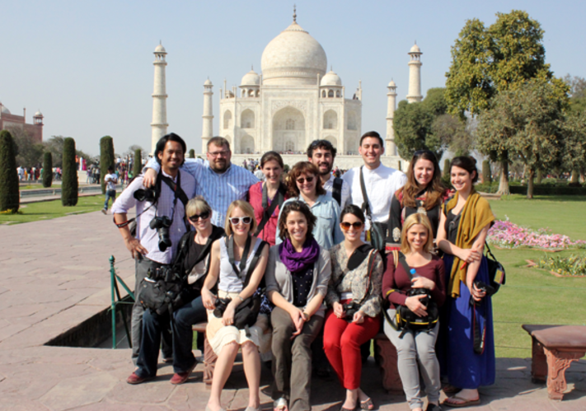
Puzzle #4
1/6 helmet
3/6 daemon
3/15 well with steps
10/11 vishnu mala
6/8 visitors

Slide 5
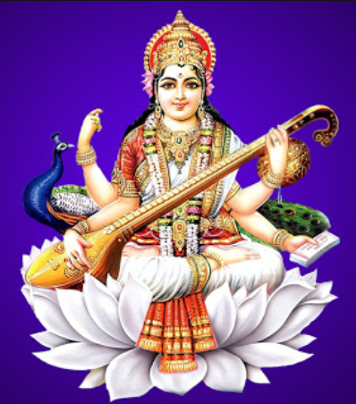
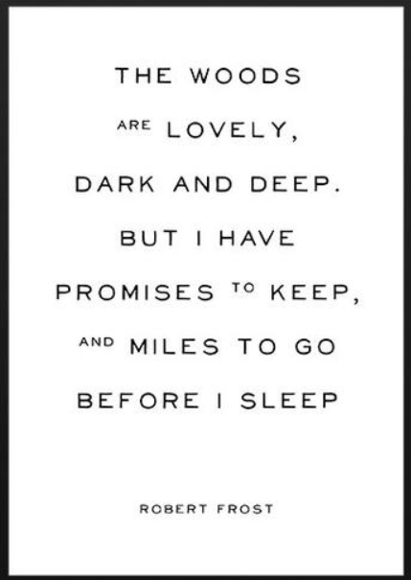
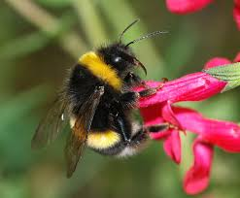
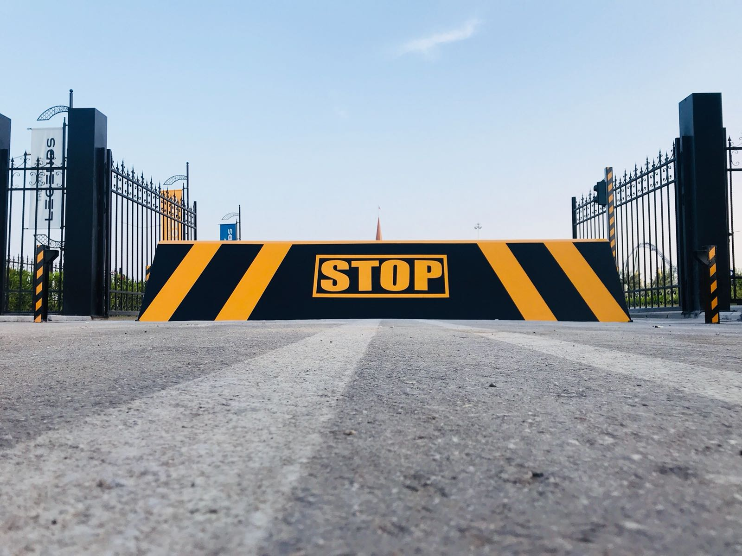
Puzzle #5
9/10 saraswathi
3/4 poem
5/9 bumblebee
6/7 buffalo
11/12 interruption

Slide 6
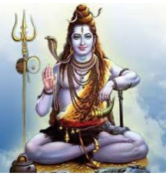
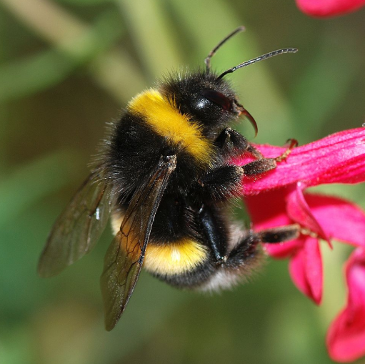
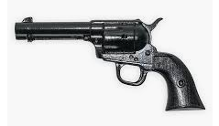
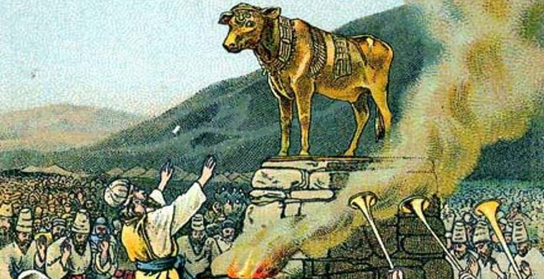
Puzzle #6
2/5 shiva
5/13 carpentar bee
6/6 pistol
4/8 idolatry
2/10 to_be_done

Slide 7
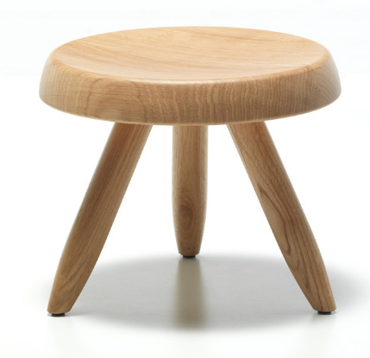
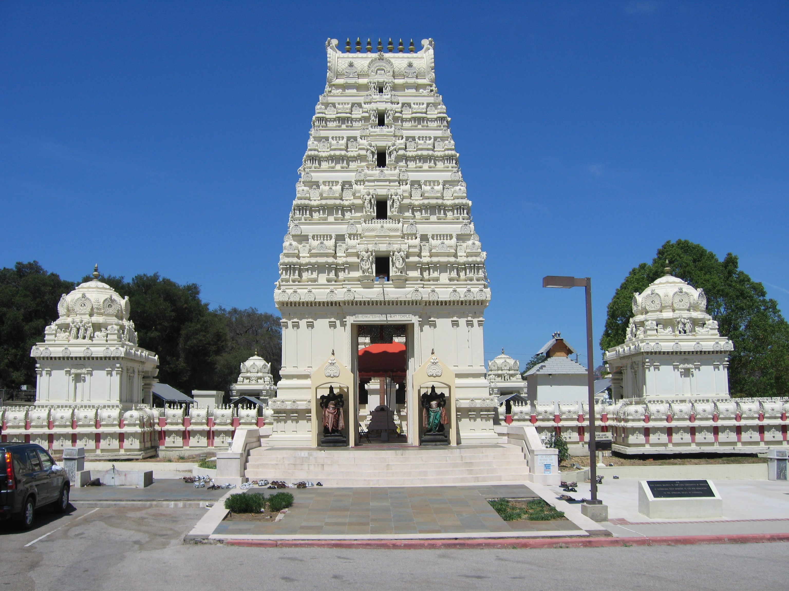
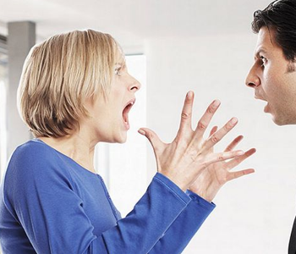
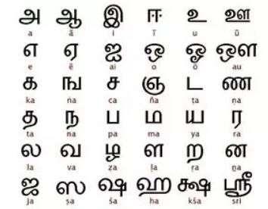
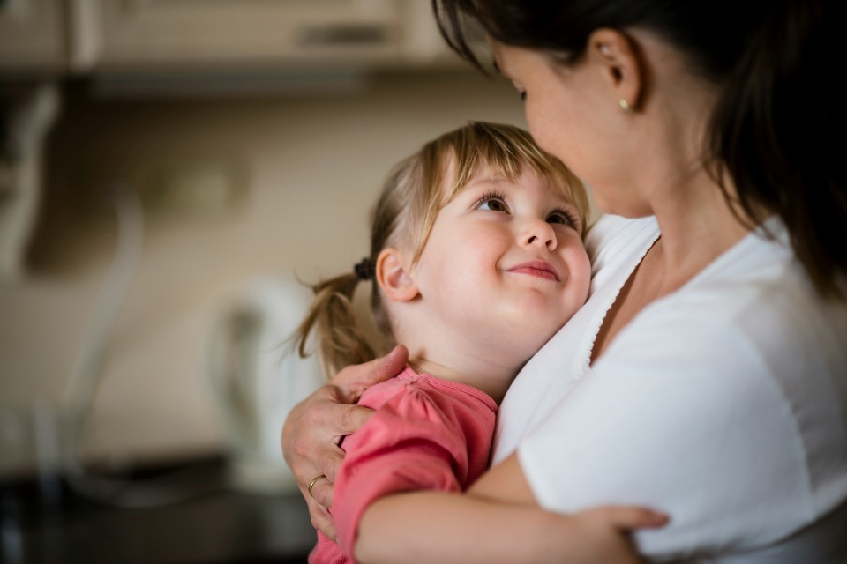
Puzzle #7
2/18 three legged stool
2/6 temple
6/17 troublesome woman
5/5 tamil
8/9 affection

Slide 8
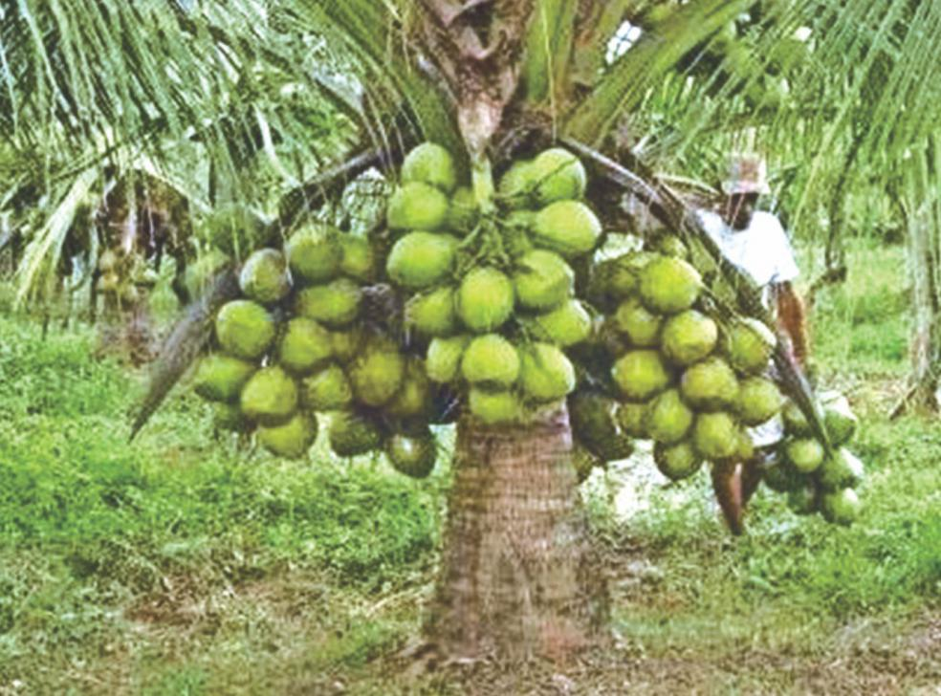
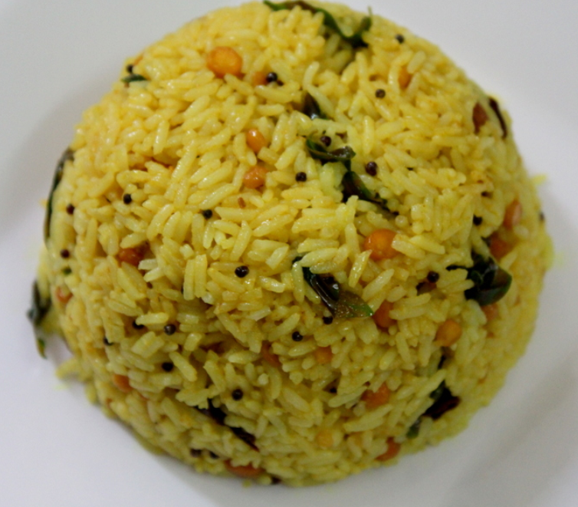
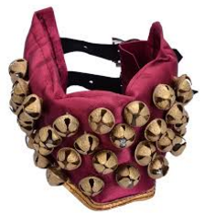
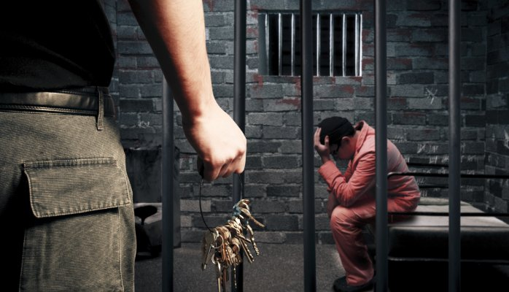
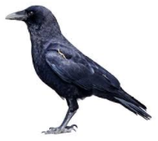
Puzzle #8
2/18 short coconut tree
2/10 lemon rice
3/5 bells
4/4 jail
3/4 crow

Slide 9
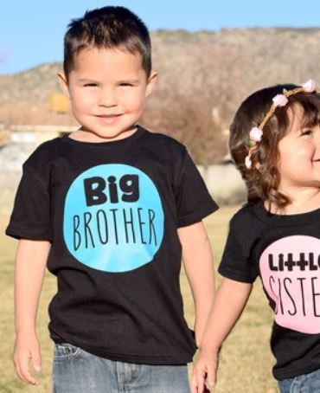

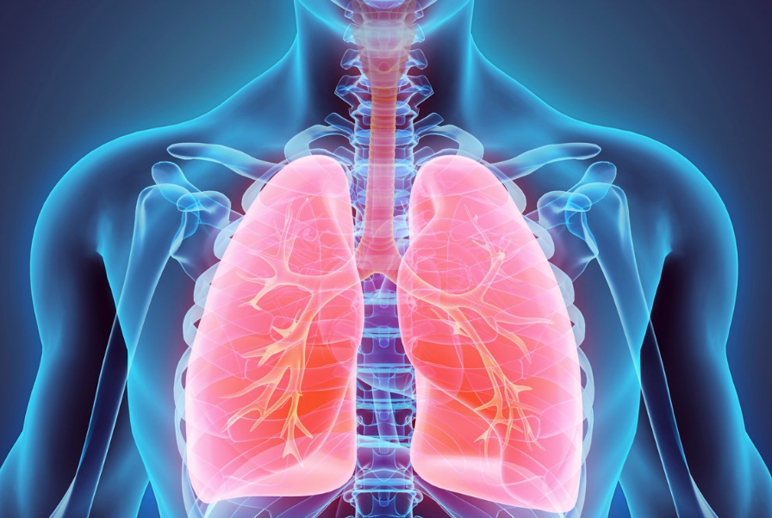
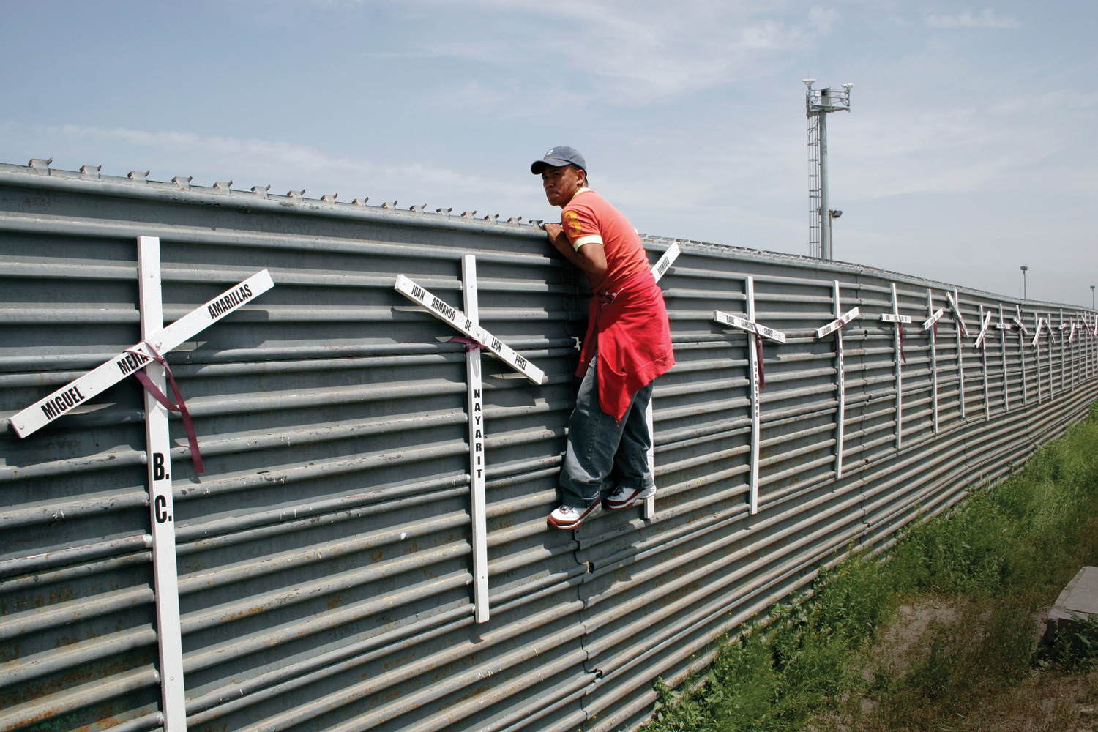
Puzzle #9
5/7 brother
4/12 interruption
1/5 lungs
2/16 illegal crossing
2/10 to_be_done

Slide 10
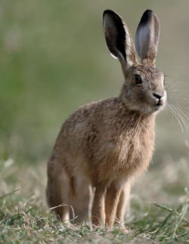
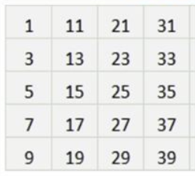
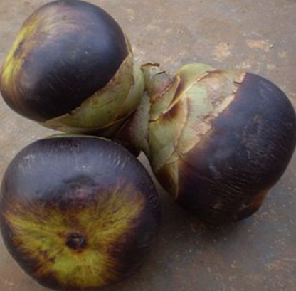
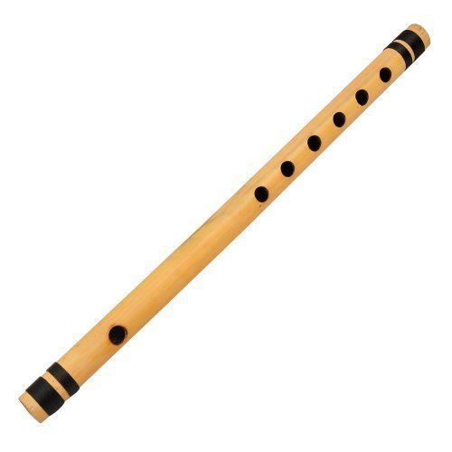
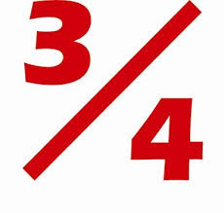
Puzzle #10
1/4 hare
9/10 odd number
9/10 tatikayalu
2/5 flute
7/8 fraction

Slide 11
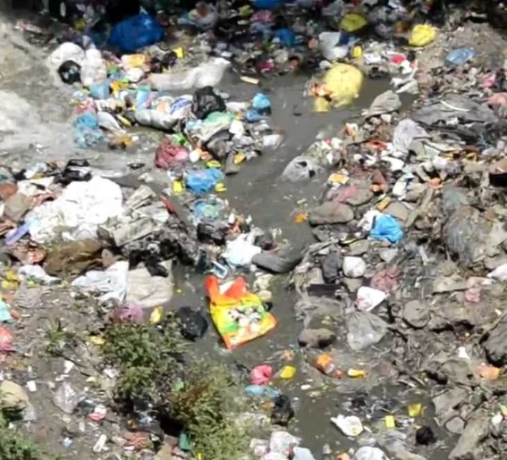
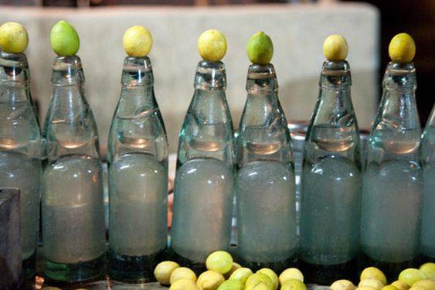

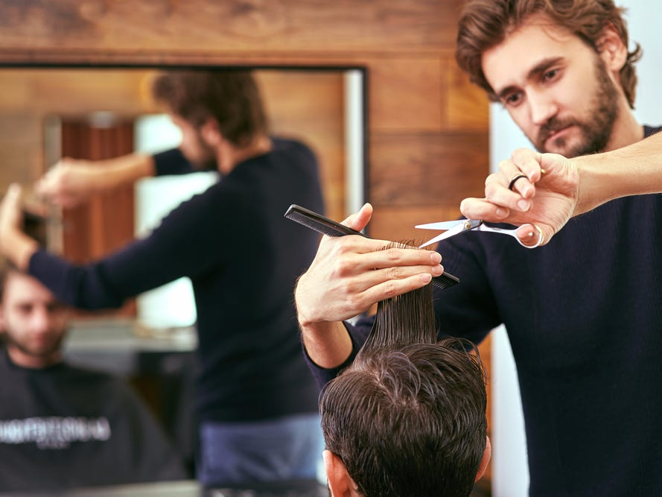
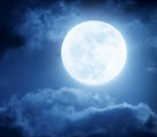
Puzzle #1
filth 5/5
lemon soda 2/10
hospital 8/8
hair stylist 9/12
moon 2/4

Slide 12
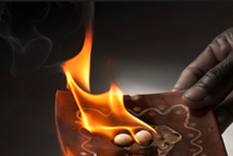

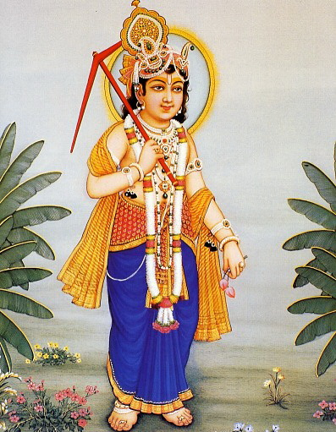
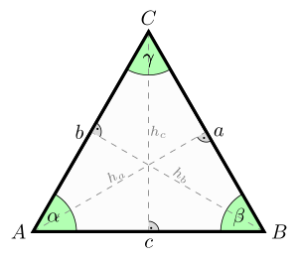

Puzzle #2
camphor 5/7
day dreams 7/10
lord balarama 1/13
triangle 7/8
barrocks 5/8

Slide 13





Puzzle #3
hooligans 1/9
inspector 5/9
bottle gourd 5/12
peninsula 8/9
fire pit stove 12/14

Slide 14





Puzzle #4
hole 1/4
long live 9/9
lotus 1/5
twelve 4/6
storage box 3/11

Slide 15




Puzzle #5
rich farmer 4/11
magnet 5/6
lord indra 1/10
family 5/6
idolatry 3/8

Slide 16



Puzzle #6
dining hall 8/11
pellipandiri 2/12
tiragali 7/8
buffalo 6/7
crow 3/4

Slide 17




Puzzle #7
manmadhuDu 7/10
spider web 5/10
lord Shiva 1/10
govindanamalu 12/13
goru chikkuDu 2/13

Slide 18





Puzzle #8
thunderstorms 2/13
seashore 2/8
black bindi 2/11
scale 4/5
passport 6/8

Slide 19





Puzzle #9
thedawn 2/7
hide 4/4
lekkalapalaka 1/13
ariselu 6/7
abbreviation 11/12

Slide 20


Puzzle #10
hair 1/4
thunderstorms 6/13
hospital 8/8
hooligans 4/9
pronouns 3/8

